Slide 1
Seizure Detection Through Time Series Modeling
3001
LiangZhi Li
Yakun Wang
Shizhan Gong

Slide 2

Outline
Problem statement
Data Description
Data Pre-processing
Modeling
Evaluation
Summary

Slide 3
Problem Statement
Epilepsy: a chronic neurological disorder that may cause brief electrical disturbances in the brain, producing a change in the sensation, awareness and behavior.
Seizure: A single occurrence of epilepsy
Epilepsy is characterized by the occurrence of recurrent seizures in the EEG signal.
Notes:
Epilepsy is a chronic neurological disorder that may cause brief electrical disturbances in the brain, producing a change in the sensation, awareness and behavior. Approximately 1% of the people in the world suffer from epilepsy. There are several treatments that can help, but this condition can't be cured.
A seizure is a single occurrence, whereas epilepsy is a neurological condition characterized by the occurrence of recurrent seizures in the EEG signals.

Slide 4
Objective:
Seizure Detection
Notes:
Brain activity (and consequently EEG pattern) during a seizure differs significantly from the activity in the normal state with respect to frequency and pattern of neural firing.
Since medication control is possible to abort seizures before they affect patient’s normal lives, early detection of seizure is significant to clinical care. Classical screening for seizure from EEG records may take multiple days, so automated seizure detection systems can be extremely useful. In this project, we want to create a new approach to detect seizure using EEG data.
The objective of our project is to detect seizure from eeg data.

Slide 5
Data description
University of Bonn
Healthy (A & B): eeg data recorded from health individual
Interictal (C & D): epileptic patient, during non-seizure event
Ictal (E): during seizure
Each group contains 100 single channel segments of 23.6 seconds duration: sampled at 173.61 Hz for each segment (4097 data points)
For each group, 20% data are randomly selected to become test set.
Notes:
Data: The EEG dataset is from the publicly available database on the website of Bonn University. EEG signals from three different groups are analyzed: group Healthy (Set A & B), group Interictal (Set C & D), and group Ictal (set E).
The EEG segments in A and B are from surface EEG recordings of five healthy volunteers with eyes open and closed respectively. The EEG segments in C and D are from EEG recordings of five epileptic patients, during seizure free intervals (dataset C) and from the hippocampal formation of the opposite brain hemisphere. Finally, EEG segments in E contain seizure activity.
Each group contains 100 single channel EEG segments of 23.6 sec duration, and each segment is sampled at 173.61 Hz (4097 data points). Thereby, the total number of data points per group is 409700.

Slide 6
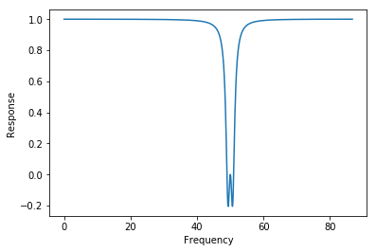
Data Pre-processing
Problem:
The power-supply noise
Method:
50 Hz Notch filter
Notes:
Before we build our models, our data still have two problems. The first is due to the power-supply noise of the acquisition system in the sampling process. So we simply pass the data through a 50 Hz notch filter to solve this problem.

Slide 7

Data Pre-processing
Problem: ill-posed EEG data
Solution: Gaussian Process Probabilistic Amplitude Demodulation (GP-PAD)
Envelope Component: slowly varying, positive
Carrier Component: quickly varying
envelope
carrier
Notes:
Another problem is due to the nature of EEG data. Thy are highly ill-posed and such kind of data may harm the performance of models that assumes the stationary of data like autoregression. Our solution is to perform a GP-PAD on the data. It will decompose the data into the multiplication of two components. A slowing varying and positive envelope component and a quickly varying carrier component.

Slide 8
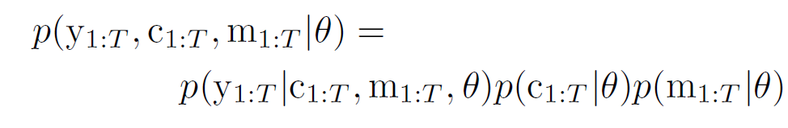


Data Pre-processing
envelope
carrier
Forward Model:
Likelihood:
Prior distribution for the carrier
1
2
3
Notes:
Based on a forward model, this model consists of the likelihood, the prior distribution over the carrier and the modulator
Likelihood: Gaussian-distributed random variable with a mean given by the product of the modulator and carrier, and a time-varying variance denoted by sigma square here
Prior distribution for the carrier is assumed to be Gaussian and uncorrelated in time

Slide 9


Data Pre-processing
envelope
carrier
Forward Model:
Prior distribution for the modulator
1
2
3
Notes:
Prior distribution for the modulator is generated by the application of a pointwise non-linear function to what we called the transformed-modulator (xt) . Xt is assumed to be drawn from a stationary Gaussian process and is a slowly varying real-valued function. The modulator signal is derived deterministically from the transformed-modulator xt by a ‘soft threshold linear’ function.

Slide 10
Data Pre-processing
envelope
carrier
Forward Model:
Make Inference through the gradient-based method
Parameter learning automatically through the Bayesian approach

Slide 11
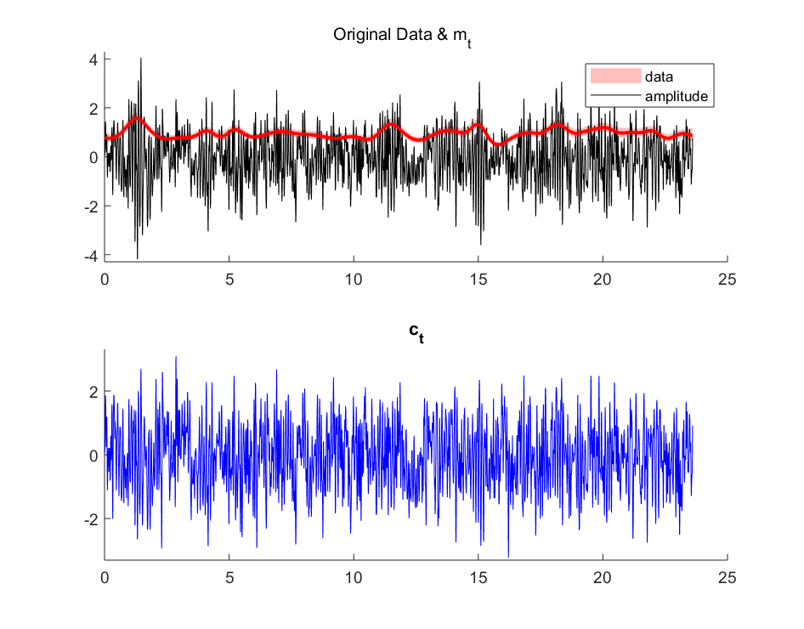

Data Pre-processing
Demo:
Healthy Data
$m_{t}$ stays around 1
Notes:
Here is a demo of our pre-processing process. The black line here represents the original data after standardization. The red line stands for the envelope, and the blue line below stands for the carrier. We could see that the envelope changes really slow here, which mean that it has a pretty long time scale, and it’s value stays close to one. Recall that the original data is demodulated into a multiplication of the m_t and c_t. M_t stays close to 1 means that c_t is close to the original data.

Slide 12
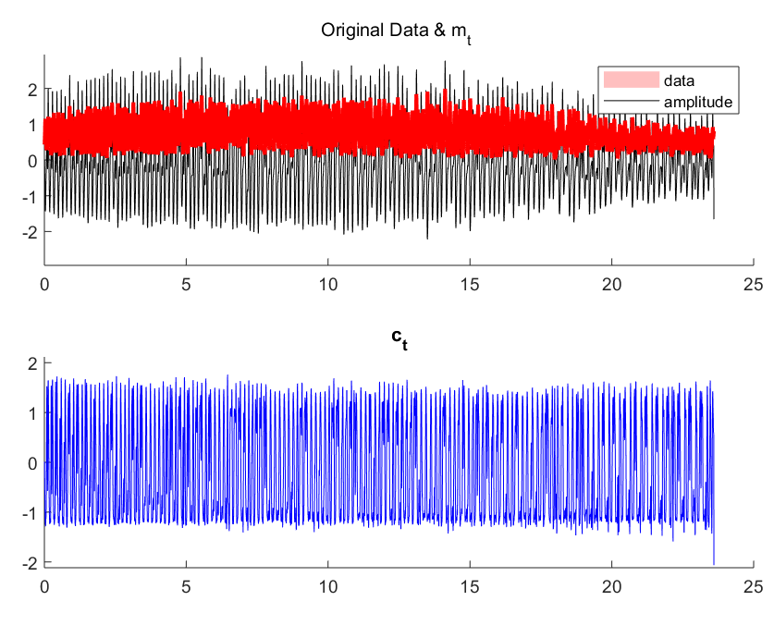

Data Pre-processing
Demo:
Ictal Data
$m_{t}$ varies fast
$c_{t}$ has regular amplitude
Notes:
Here is a demo using data from the ictal group. The data clearly shows different patterns. Compared with the demo before, the envelope here varies faster and greater, which means that The original data is extremely non-stationary, and the difference between the original data and the c_t is large. The ct after demodulation has regular amplitude.

Slide 13
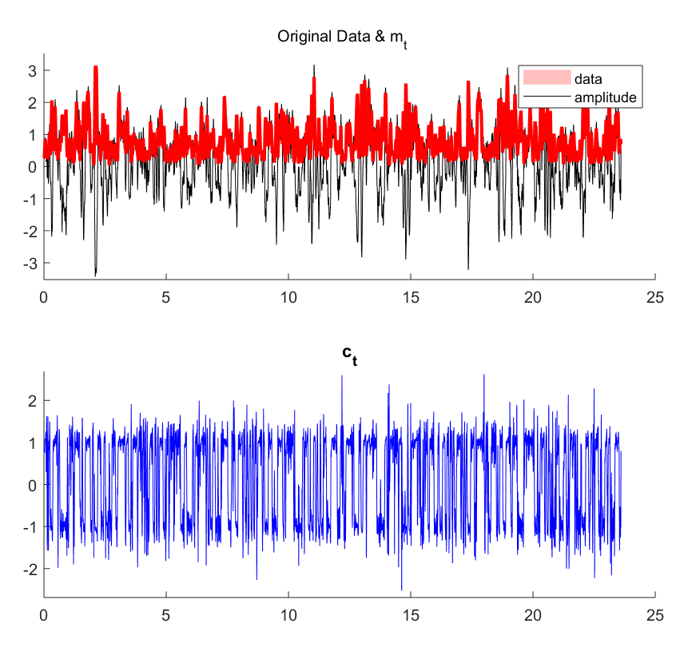
Data Pre-processing
Demo:
Interictal Data
Notes:
Here is another demo of our pre-processing process using data from the interictal group. It seems to stay at the middle of the previous two demos. This is pretty intuitive since interictal state is kind of one between healthy and ictal state.

Slide 14

Data Pre-processing
Observation:
Automatically learn the time-scale
Capture the difference among groups
Preserve the patterns
Only $c_{t}$ is kept for modeling
Notes:
Now from the the demos, we can tell that our pre-processing process can first, Automatically learn the time-scale from data, and therefore it captures the difference among groups. Meanwhile c_T still preserve the key patterns of the original data. We only kept c_t , which has higher reliability to be stationary, for our later modelling process.

Slide 15
Modeling
Auto Regressive (AR) Model
• Fit an AR model to each individual series
• Set a maximum order and select the best order of the model based on BIC criterion
• Extract model weight as features (Insert 0 for higher orders)
• Classification by multilayer perceptron
Notes:
After all this preprocessing, we built several time series models to do the classification. We first try simple AR model. We fit individual series an AR model, and determine the order of the model based on BIC criterion, which can achieve simpler model than AIC. The weight corresponding to higher order are set to be 0. Finally, for each series, we obtain a series of weights. We utilize these weight as feature, and plug in a multilayer perceptron to do classification.

Slide 16
Modeling
Hidden Markov Model (HMM)
• Separate data sets into the data sets for each class
• Train one HMM per class
• On the test set compare the MAP of each model to classify each series
Notes:
Later we tried Hidden markov model. We first separate training data into three class, and train one HMM per class. Therefore we have three different HMM whose transition probability and emission probability are fitted through training data. For each test series, we use viterite algorithm to calculate the MAP corresponding to each model and select the model with maximum MAP as the most suitable one. The label of each series are set to be the label of that most suitable model.

Slide 17
Modeling
Recurrent Neural Network (RNN)
• Cut each long series into 50 short series
• Feed each short series into a gated recurrent unit (GRU)
• Feed the last hidden state of the GRU into a fully connected layer with softmax output
• Each short series would have a predicted label
• Determine the label of original series through majority voting
Notes:
Finally we also tried recurrent neural network. Since RNN usually require lots of training data, and too long series will raise some computational issue. We cut each long series into 50 short ones with the same label, then feed each series into a gated recurrent unit. The last hidden state of the GRU are fed into a fully connected layer to do the classification. Therefore each short series would have a predicted label. The label of the original series are determined through majority voting.

Slide 18
Evaluation
Hyperparameter tuning and model selection through 5-fold cross validation
Model | Validation Acc
AR | 0.8750
HMM | 0.7325
RNN | 0.9375
Notes:
We tune the hyperparameter through 5-fold cross validation. Since the label of our model is kind of balanced, we select the model based the accuracy on the validation set. From the results we can see RNN performs the best, which achieve an accuracy of 94 percent in the validation set, and HMM performs the worst.

Slide 19
Summary
• Built and compared several time series models on EEG classification
• Explored the effects of several data preprocessing methods on model performance
• Obtained a seizure detection model which achieves 0.98 accuracy on the test set (health: 1, interictal: 0.925, ictal: 1)
Notes:
Finally we evaluate our best RNN model on the test set, and achieve an accuracy of 0.98. These are the summary of our work. Our project also have some limitation, such as our data is not large enough to build a robust model, and we did not incorporate the amplitude of the signal in our model. In the future, we would explore more models to correct these limitations. Thanks.

Slide 20
Reference
Andrzejak, Ralph G., et al. "Indications of nonlinear deterministic and finite-dimensional structures in time series of brain electrical activity: Dependence on recording region and brain state." Physical Review E 64.6 (2001): 061907.
Golmohammadi, Meysam, et al. "Gated recurrent networks for seizure detection." Signal Processing in Medicine and Biology Symposium (SPMB), 2017 IEEE. IEEE, 2017.
Hussein, Ramy, et al. "Epileptic Seizure Detection: A Deep Learning Approach." arXiv preprint arXiv:1803.09848 (2018).
Thodoroff, Pierre, Joelle Pineau, and Andrew Lim. "Learning robust features using deep learning for automatic seizure detection." Machine learning for healthcare conference. 2016.
Faul, Stephen, et al. "Gaussian process modeling of EEG for the detection of neonatal seizures." IEEE Transactions on Biomedical Engineering 54.12 (2007): 2151-2162.
Mousavi, S. R., M. Niknazar, and B. Vosoughi Vahdat. "Epileptic seizure detection using AR model on EEG signals." Biomedical engineering conference, 2008. CIBEC 2008. Cairo International. IEEE, 2008.
Abdullah, Mohd Hafidz, Jafri Malin Abdullah, and Mohd Zaid Abdullah. "Seizure detection by means of hidden Markov model and stationary wavelet transform of electroencephalograph signals." Biomedical and Health Informatics (BHI), 2012 IEEE-EMBS International Conference on. IEEE, 2012.
Turner, Richard E., and Maneesh Sahani. "Demodulation as probabilistic inference." IEEE Transactions on Audio, Speech, and Language Processing 19.8 (2011): 2398-2411.

